Slide 1

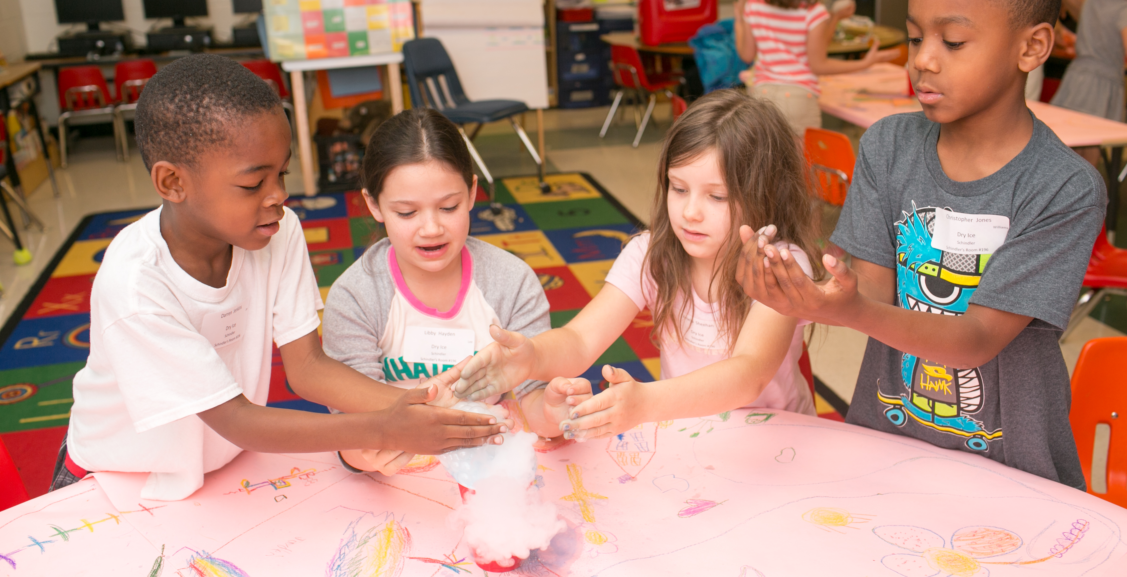

Room Parent Training
Kate Scarborough and Farrah Ryan
RNE PTA Room Parent Co-Chairs
2019-2020

Slide 2
Room Parent Roles
Communication / Finance
Creative / Party
Academic / Foundation Liaison

Slide 3
Important Tips:
Every teacher should receive 3 gifts: Birthday/Half-Birthday (summer birthday), Holiday, End of Year (If your class has a 2nd teacher and/or Para-pro, they should also receive the gifts listed above.)
Use the Favorites list!
Don’t be afraid to ask parents to send in supplies! (Do not blow your funds on raffle baskets/parties.)
Being a Room Parent DOES NOT mean you have carte blanche to enter the classroom whenever you want. Only visit your child’s class at times that are agreed upon by the Teacher

Slide 4
Room Parent Role Communication/Finance
Main point of contact for teacher
Creates classroom directory (optional)
Creates classroom email group (Google, Yahoo, etc.) -- Only person to email parent group
Introduction email (include teacher favorites list, attach directory & encourage parents to update Membership Toolkit teacher information)
Forwards emails from PTA/Foundation/other Room Parents in a timely manner
Organizes volunteers for classroom activities/Makes parents aware of Volunteer, PTA & Support Opportunities
Notes:
Create a parent e-mail distribution list ASAP. The beginning of a contact list is included in training packet. If you do not have everyone’s contact information on the attached sheets, ask again at Curriculum Night for parents to give you their contact information. Your teacher may be able to help you with missing information.
Directory should have a group or individual photo reference so that the teachers can use it for subs and parents can identify friends/classmates.
General rule of thumb: e-mails to parents should be short & concise. Spell out clearly what is needed, how they can do it, how long it will take and any deadlines.
If possible, group multiple pieces of information together in one email so you aren’t bombarding parents with a ton of different emails. We don’t want them to tune you out.
Reach out to ESOL (English for Speakers of other Languages) families.
Put a copy of important emails in Friday folders for those parents who do not have an email address.
Depending on Reading programs - Coordinate Reader volunteers (1st grade only) and Mystery Reader volunteers (depends on teacher and grade level whether or not they do this).

Slide 5
Room Parent Role Communication/Finance (Continued)
Responsible for collecting and managing funds for classroom activities and teacher gifts
Contact parents before Curriculum Night to let them know you will be collecting money. (Venmo/PayPal allowed) Send ‘thank you’ to parents after receiving their money.
Creates classroom budget and makes purchases or reimburses other room parents.
MANDATORY BUDGET REPORTING in December & May
The class budget must be $0 at the end of the year
DO NOT keep money in an account that charges fees!
Notes:
Create a parent e-mail distribution list ASAP. The beginning of a contact list is included in training packet. If you do not have everyone’s contact information on the attached sheets, ask again at Curriculum Night for parents to give you their contact information. Your teacher may be able to help you with missing information.
Directory should have a group or individual photo reference so that the teachers can use it for subs and parents can identify friends/classmates.
General rule of thumb: e-mails to parents should be short & concise. Spell out clearly what is needed, how they can do it, how long it will take and any deadlines.
If possible, group multiple pieces of information together in one email so you aren’t bombarding parents with a ton of different emails. We don’t want them to tune you out.
Reach out to ESOL (English for Speakers of other Languages) families.
Put a copy of important emails in Friday folders for those parents who do not have an email address.
Depending on Reading programs - Coordinate Reader volunteers (1st grade only) and Mystery Reader volunteers (depends on teacher and grade level whether or not they do this).

Slide 6

Room Parent Info
All Communication Room Parents will be assigned in the system with Room Parent Rights (done by PTA Directory Team)
Room Lists Already Created for Class Emails - TIME SAVING!
  Room parents have the option of using MSA to send group emails to their class with extreme ease
Create Volunteer Sign-ups for Class Needs
  Think Sign-up Genius built in to the directory with everyone’s names and emails already there
Link events to specific grade/teacher
Encourage families to use MSA app/website as the great resource it is!
Short 3min Video that highlights just how helpful & simple this can be! Room Parent Video
Are you INTERESTED in using MSA this year - contact Emily Shively for more info! emilyelizabethshively@gmail.com

Slide 7
Room Parent Role
Creative/Party
Responsible for creating the auction basket for Family Fun Night (Grades PK-2 ONLY) – October 18th, 2019
Plan 2 parties per classroom per year (party dates determined by school). Only room parents are allowed at parties (unless otherwise noted by teacher).
Work closely with teacher on party activities/format
Send Communications Room Parent a list of supplies needed from parents
Notes:
Creative Room Parent will be responsible for coordinating collection of items for a themed basket and putting the basket together.
Ask for donations only from your class parents. Refer to Contribution Form on weebly site.
DO NOT SOLICIT LOCAL BUSINESSES.
Coordinate basket theme with your teacher. Class Basket Form (I)
Finished baskets will be due in October. More details will be sent out.

Slide 8
Room Parent Role
Academic / Foundation Liaison
  Responsible for coordinating the following:
Box Tops (paper and remind parents about digital)
Oversee communications between the Foundation & classroom
Manage Science Lab Volunteer Sign Ups
Responsible for creating the auction basket for the spring soiree (Grades 3-5 ONLY) – April 24th, 2020
Scholastic Book Orders (if needed)
Notes:
Box Tops are collected twice per year in September/October and January/February.
Detailed information about how to collect and submit Box Tops will be given to the Academic Room Parent well in advance of the due date.
If your Box Tops are not submitted correctly, they will be returned to the Academic Room Parent for the opportunity for the submission to be corrected and resubmitted. In the event the submission is still not submitted correctly, the class will forfeit an opportunity to earn funds during that collection period.

Slide 9
General Information
Delegate / PLEASE use General Volunteers
Contact Kate & Farrah with any questions or problems
Tools
  https://www.rnepta.com/room-parents/
  https://www.rnepta.com/teacher-favorites/
  volunteerspot.com
  signupgenius.com

Slide 10
Timeline
Immediately
Email Teacher to discuss preferred method of communication, volunteer opportunities, class needs, etc. (Communications / cc Other Room Parents)
Introduce RP team at Curriculum night: explain your roles & COLLECT MONEY!
Distribute Teacher Favorites List and Class Directory (Communication Room Parent)
Send Introduction Email to Parents - include deadline to submit class funds and attachments for Teacher Favorites List and Class Directory (Communication Room Parent)
Fall
Email thank you notes for class funds collection (Communication/Finance Room Parent)
Remind parents to collect/turn-in Box Tops (Communication/Finance Room Parent) - Fall collection drive is September 23rd-October 4th
Solicit donations and create Family Fun Night basket (Grades PK-2 ONLY) – October 18th, 2019
Notes:
This timeline of Room Parent activities is for your reference and is an approximation of the duties and due dates.
If an event or task has a specific deadline, more information will be sent out at a later date.
Also, this list might change in the future, so we’ll keep you posted about that too!
If teacher birthday falls within school months, the Finance Room Parent is responsible for getting a gift and the Communication Room Parent is responsible for sending out an email to parents telling them a gift was given on behalf of the entire class.

Slide 11
Timeline
Winter
Contact Teacher to find out needs for Winter Party. Create a sign up of materials needed from parents & send to Communication Room Parent. (Creative/Party Room Parent)
Buy holiday gift for teacher(s) and email class parents to let them know what gift the class is giving. (Communication/Finance Room Parent)
Collect & Turn in Box Tops - Spring drive is January 13-24, 2020 (Academic/Foundation Room Parent)
Notes:
This timeline of Room Parent activities is for your reference and is an approximation of the duties and due dates.
If an event or task has a specific deadline, more information will be sent out at a later date.
Also, this list might change in the future, so we’ll keep you posted about that too!
If teacher birthday falls within school months, the Finance Room Parent is responsible for getting a gift and the Communication Room Parent is responsible for sending out an email to parents telling them a gift was given on behalf of the entire class.

Slide 12
Timeline
Spring
3rd, 4th & 5th: Decide on Spring Soiree Basket theme, collect items/money and turn in completed basket for Spring Soiree on April 24th (Academic/Foundation Room Parent)
Contact Teacher to find out needs for End of Year Party. Create a sign up of materials needed from parents & send to Communication Room Parent. (Creative/Party Room Parent)
Purchase End of Year gift for teacher(s) and let class parents know. (Communication/Finance Room Parent)

Slide 13
Room parent materials
In folder:
  Room parent role sheet – PLEASE fill out and return
  General Volunteer Sign-Up sheet
  Class Directory
Visit: https://www.rnepta.com/room-parents/ – All documents you need are on this site. Best source of information for you!

Slide 14
Thank You!
Please don’t forget to turn in your Room Parent Roles List

Slide 15

Room Parent Training
Kate Scarborough and Farrah Ryan
katescarborough725@gmail.com and farrahfryan@yahoo.com
Or roomparentrne@gmail.com
RNE PTA Room-Parent Co-Chairs
2019-2020

